Slide 1
Spell Checker
Using Hash tables And Levenshtein distance algorithm
From –Surya KN
1NH21CS242
Notes:
© Copyright PresentationGO.com – The free PowerPoint and Google Slides template library

Slide 2
Introduction
Spell Checker
Objectives: To develop a simple spell checker program in C that uses Hash tables and the Levenshtein distance algorithm to check and correct spelling errors.
Scope: The program will be implemented in C, and will use hash tables to store the dictionary and the Levenshtein distance algorithm to measure the similarity between words
Surya KN
1NH21CS242
Notes:
© Copyright PresentationGO.com – The free PowerPoint and Google Slides template library

Slide 3
Requirements
Spell Checker
Hardware:
Intel Pentium processor or later. RAM 512MB or more.Storage of 128GB or more.
Software:
Windows 7 32-bit/64-bit or higher .GCC compiler and any text editor(Vscode, CodeBlocks etc) .
Surya KN
1NH21CS242
Notes:
© Copyright PresentationGO.com – The free PowerPoint and Google Slides template library

Slide 4
Roadmap
Spell Checker
Research: Review existing literature on spell checker algorithms and hash table data structures to determine the most suitable approach for the project.
Design algorithm: Develop an algorithm that uses a hash table to store the dictionary and the Levenshtein distance algorithm to measure the similarity between words. The algorithm should be able to check if a given word exists in the dictionary, and suggest corrections if the word is spelled incorrectly.
Implement code: Write the code in C, using appropriate data structures and algorithms to implement the spell checker. Test the code to ensure it is working correctly.
Surya KN
1NH21CS242
Notes:
© Copyright PresentationGO.com – The free PowerPoint and Google Slides template library

Slide 5
Roadmap
Spell Checker
Test program: Verify the accuracy and performance of the spell checker using a variety of test cases.
Refine and optimize: Make any necessary changes to the code to improve the accuracy or performance of the spell checker.
Document and present: Document the project, including the design, implementation, and results, and present the project to stakeholders or classmates.
Surya KN
1NH21CS242
Notes:
© Copyright PresentationGO.com – The free PowerPoint and Google Slides template library

Slide 6
Design
Spell Checker
c
Taking input from the user
Comparing it with the predefined dictionary which is stored in hashtables
Specify if the given word is correct or not, if wrong give the nearest word using levenshtein distance algorithm
Input
c
Checking in dictionary
output
c
Surya KN
1NH21CS242
Notes:
© Copyright PresentationGO.com – The free PowerPoint and Google Slides template library

Slide 7
Hash Tables
Spell Checker
A hash table is a data structure that stores data in an array-like structure, using a hash function to map the data to a specific index in the array.
The hash function takes an input (called the key) and maps it to an integer index in the array. The data associated with the key is then stored at that index in the arrayComparing it with the predefined dictionary which is stored hashtables
Hash tables have an average-case time complexity of O(1) for both insertion and retrieval operations, making them faster than other data structures such as linked lists or binary trees.
Here XXHASH library is used for implementing a efficient hash function so a large number of words can be stored with low collision rates.
Surya KN
1NH21CS242
Notes:
© Copyright PresentationGO.com – The free PowerPoint and Google Slides template library

Slide 8
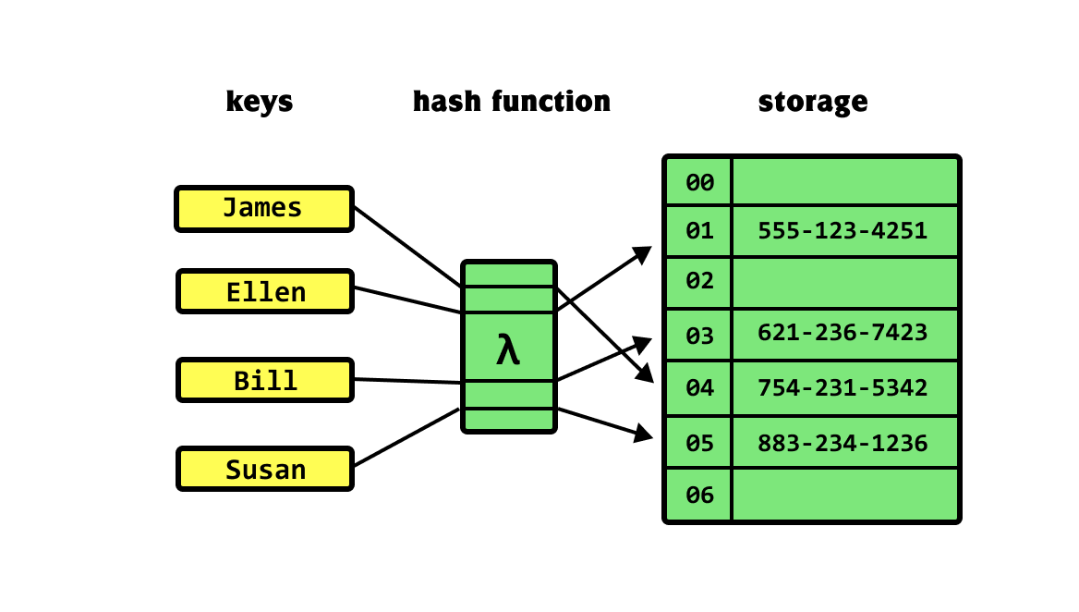
Hash Tables
Spell Checker
Surya KN
1NH21CS242
Notes:
© Copyright PresentationGO.com – The free PowerPoint and Google Slides template library

Slide 9
Methodology
Spell Checker
The program starts by reading a text file (dict.txt) containing a list of valid English words and inserting each word into a hash table using the insertWord function.
The user is then prompted to enter a word to be checked for spelling errors.
The program checks if the entered word exists in the hash table. If it does, the program returns a message stating that the word is spelled correctly. If it doesn't exist, the program proceeds to the next step.
The program uses the Levenshtein Distance algorithm implemented in the LevenshteinDistance function to find the closest words to the entered word
Surya KN
1NH21CS242
Notes:
© Copyright PresentationGO.com – The free PowerPoint and Google Slides template library

Slide 10
Methodology
Spell Checker
For each word in the hash table, the LevenshteinDistance function is called to compute the distance between the entered word and the word in the hash table. If the distance is less than the minimum distance found so far, the word is added to an array of closest words and the minimum distance is updated.
If multiple words have the same minimum distance, up to 10 of them are stored in the closest words array.
The program then prints the closest words to the entered word.
The program then terminates.
Surya KN
1NH21CS242
Notes:
© Copyright PresentationGO.com – The free PowerPoint and Google Slides template library

Slide 11
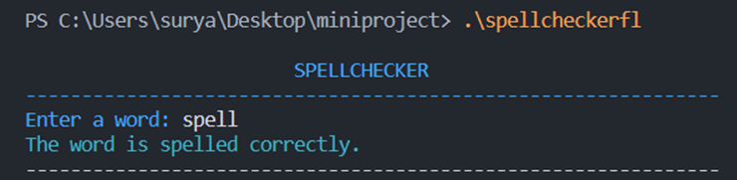
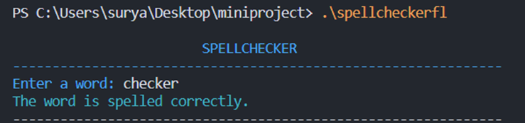
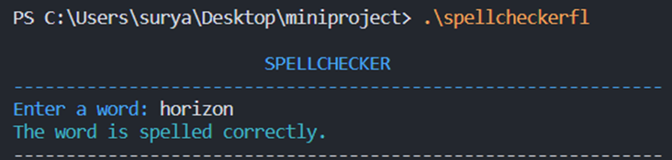
Sample Output
Spell Checker
Surya KN
1NH21CS242
Notes:
© Copyright PresentationGO.com – The free PowerPoint and Google Slides template library

Slide 12
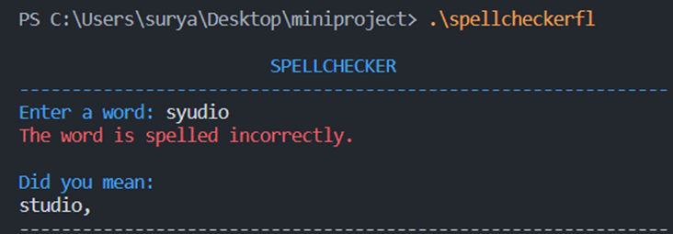
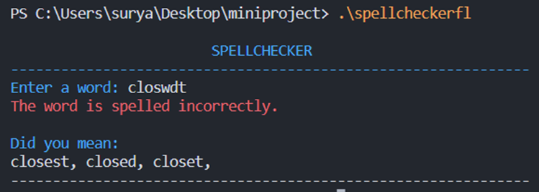
Sample Output
Spell Checker
Surya KN
1NH21CS242
Notes:
© Copyright PresentationGO.com – The free PowerPoint and Google Slides template library

Slide 13
Spell Checker
Thank You!!
Surya KN
1NH21CS242
Notes:
© Copyright PresentationGO.com – The free PowerPoint and Google Slides template library

